Slide 1

School of Computing Science and Engineering
School of Computing Science and Engineering
Program Name: BTech , 5 SEM
Course Code : E2UC502T
Course Name : Software Testing & Quality Assurance
Dr. Azath Hussain PhD.

Slide 2
School of Computing Science and Engineering
“Black Box Testing"
WHAT IS BLACK BOX TESTING?
Black box testing involves looking at the specifications and does not require examining the code of a program. Black box testing is done from the customer's viewpoint.
The test engineer engaged in black box testing only knows the set of inputs and expected outputs and is unaware of how those inputs are transformed into outputs by the software.
Black box testing requires a functional knowledge of the product to be tested. It does not mandate the knowledge of the internal logic of the system nor does it mandate the knowledge of the programming language used to build the product.
Our tests in the next example were focused towards testing the features of the product (lock and key), the different states, we already knew the expected outcome. You may check if the lock works with some other key (other than its own).

Slide 3
School of Computing Science and Engineering
“Black Box Testing "
Functionality What you need to know to use
Features of a lock: It is made of metal, has a hole provision to lock, has a facility to insert the key, and the keyhole ability to turn clockwise or anticlockwise.
Features of a key: It is made of metal and created to fit into a particular lock's keyhole.
Actions performed: Key inserted and turned clockwise to lock & and turned anticlockwise to unlock
States: Locked , Unlocked
Inputs: Key turned clockwise or anticlockwise
Expected outcome: Locking , Unlocking

Slide 4
School of Computing Science and Engineering
“Black Box Testing "
WHY BLACK BOX TESTING ?
Black box testing helps in the overall functionality verification of the system under test.
Black box testing is done based on requirements It helps in identifying any incomplete, inconsistent requirement as well as any issues involved when the system is tested.
Black box testing addresses the stated requirements as well as implied requirements Inclusion of dates, page header, and footer may not be explicitly stated in the report generation requirements specification.
Black box testing encompasses the end user perspectives Since we want to test the behavior of a product from an external perspective, end-user perspectives are an integral part of black box testing.
Black box testing handles valid and invalid inputs: Testing from the end-user perspective includes testing for these error or invalid conditions. This ensures that the product behaves as expected in a valid situation and does not hang or crash when provided with an invalid input. These are called positive and negative test cases.

Slide 5
School of Computing Science and Engineering
“Black Box Testing "
WHEN TO DO BLACK BOX TESTING?
Black box testing activities require involvement of the testing team from the beginning of the software project life cycle, regardless of the software development life cycle model chosen for the project.
Testers can get involved right from the requirements gathering and analysis phase for the system under test. Test scenarios and test data are prepared during the test construction phase of the test life cycle, when the software is in the design phase.
Once the code is ready and delivered for testing, test execution can be done. All the test scenarios developed during the construction phase are executed. Usually, a subset of these test scenarios is selected for regression testing.

Slide 6
School of Computing Science and Engineering
“Black Box Testing "
HOW TO DO BLACK BOX TESTING? Since we are testing external functionality in black box testing, we need to test as much of the external functionality as possible, uncovering as many defects as possible, in as short a time as possible.
The various techniques we will discuss are as follows.
1. Requirements based testing
2. Positive and negative testing
3. Boundary value analysis
4. Decision tables
5. Equivalence partitioning
6. State based testing
7. Compatibility testing
8. User documentation testing
9. Domain testing

Slide 7
School of Computing Science and Engineering
“Black Box Testing "
1. Requirements Based Testing:-
Requirements testing deals with validating the requirements given in the Software Requirements Specification (SRS) of the software system.
Explicit requirements are stated and documented, Implied or implicit requirements are those that are nor documented but assumed to be incorporated in the system.
A detailed review of the requirements specification is precondition for requirements testing and it ensures that they are consistent, correct, complete, and testable.
This process ensures that some implied requirements are converted and documented as explicit requirements, thereby bringing better clarity to requirements.
All explicit requirements (from the Systems Requirements Specifications) and implied requirements (inferred by the test team) are collected and documented as “Test Requirements Specification” (TRS). Requirements based testing can also be conducted based on such a TRS, as it captures the testers’ perspective as well.

Slide 8
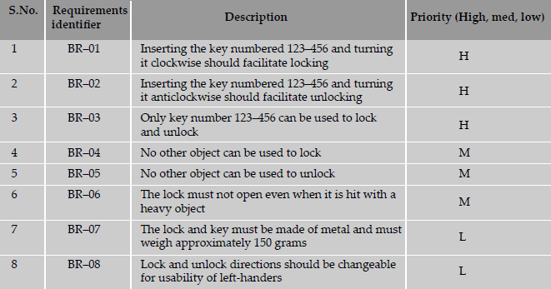
School of Computing Science and Engineering
“Black Box Testing "
Table 1.1 Sample requirements specification for lock and key system.

Slide 9
School of Computing Science and Engineering
“Black Box Testing "
Requirements are tracked by a Requirements Traceability Matrix (RTM). An RTM traces all the requirements from their genesis through design, development, and testing.
As we move further down in the life cycle of the product, and testing phases, the cross-reference between requirements and the subsequent phases is recorded in the RTM.
Once the test case creation is completed, the RTM helps in identifying the relationship between the requirements and test cases. The following combinations are possible.
One to one—For each requirement there is one test case (for example, BR-01)
One to many—For each requirement there are many test cases (for example, BR-03)
Many to one—A set of requirements can be tested by one test case
Many to many—Many requirements can be tested by many test cases
One to none—The set of requirements can have no test cases. The test team can take a decision not to test a requirement due to non-implementation or the requirement being low priority (for example, BR-08)

Slide 10
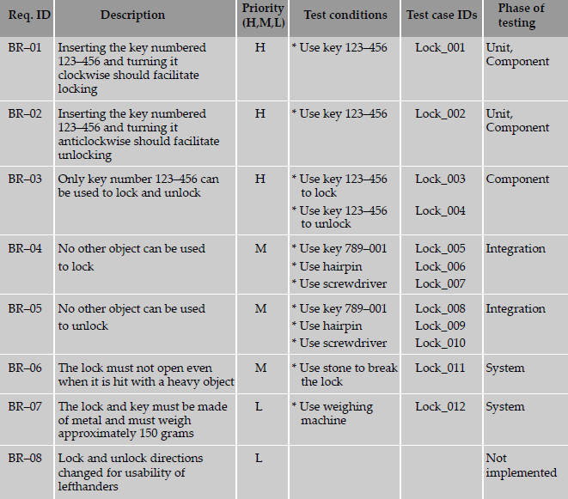
School of Computing Science and Engineering
“Black Box Testing "
Table 1.2 Sample Requirements Traceability Matrix.

Slide 11
School of Computing Science and Engineering
“Black Box Testing "
The Requirements Traceability Matrix provides information on various test metrics.
Requirements addressed priority-wise—
Number of test cases requirement-wise—
Total number of test cases prepared—
Once the test cases are executed, the test results can be used to collect metrics such as
Total number of test cases (or requirements) passed—
Total number of test cases (or requirements) failed—
Total number of defects in requirements—
Number of requirements completed—

Slide 12
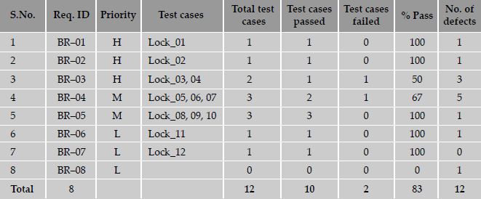
School of Computing Science and Engineering
“Black Box Testing "
Table 4.3 Sample test execution data.

Slide 13
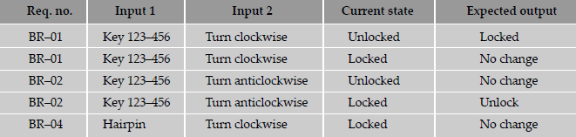
School of Computing Science and Engineering
“Black Box Testing "
1.2 Positive and Negative Testing
Positive testing tries to prove that a given product does what it is supposed to do. When a test case verifies the requirements of the product with a set of expected output, it is called positive test case. The purpose of positive testing is to prove that the product works as per specification and expectations. A product delivering an error when it is expected to give an error, is also a part of positive testing.
Positive testing can thus be said to check the product's behavior for positive and negative conditions as stated in the requirement.
Table 1.4 Example of positive test cases. e requirement.

Slide 14
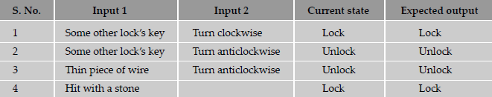
School of Computing Science and Engineering
“Black Box Testing "
Negative testing is done to show that the product does not fail when an unexpected input is given. The purpose of negative testing is to try and break the system.
Negative testing covers scenarios for which the product is not designed and coded. In other words, the input values may not have been represented in the specification of the product. A negative test would be a product not delivering an error when it should or delivering an error when it should not.
Table 1.5 Negative test cases.

Slide 15
School of Computing Science and Engineering
“Black Box Testing "
1.3 Boundary Value Analysis
Conditions and boundaries are two major sources of defects in a software product. Most of the defects in software products hover around conditions and boundaries. By conditions, we mean situations wherein, based on the values of various variables, certain actions would have to be taken. By boundaries, we mean “limits” of values of the various variables.
Boundary value analysis (BVA), a method useful for arriving at tests that are effective in catching defects that happen at boundaries. Boundary value analysis believes and extends the concept that the density of defect is more towards the boundaries.
Number of units bought Price per unit
First ten units (that is, from 1 to 10 units) $5.00
Next ten units (that is, from units 11 to 20 units) $4.75
Next ten units (that is, from units 21 to 30 units) $4.50
More than 30 units $4.00

Slide 16
School of Computing Science and Engineering
“Black Box Testing "
Boundary value analysis is useful to generate test cases when the input (or output) data is made up of clearly identifiable boundaries or ranges.
Boundary value testing is extremely useful in uncovering defects is when there are internal limits placed on certain resources, variables, or data structures.
Consider a database management system (or a file system) which caches the recently used data blocks in a shared memory area. Usually such a cached area is limited by a parameter that the user specifies at the time of starting up the system.
Assume that the database is brought up specifying that the most recent 50 database buffers have to be cached. When these buffers are full and a 51st block needs to be cached, the least recently used buffer—the first buffer—needs to be released, after storing it in secondary memory. As you can observe, both the operations—inserting the new buffer as well as freeing up the first buffer—happen at the “boundaries.”

Slide 17
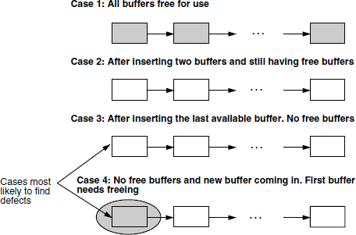
School of Computing Science and Engineering
“Black Box Testing "
Figure 1.2 Various test cases of buffer management.

Slide 18
School of Computing Science and Engineering
“Black Box Testing "
1.4 Decision Tables:To illustrate the use of conditions (and decision tables) in testing, let us take a simple example of calculation of standard deduction on taxable income.
1. The first factor that determines the standard deduction is the filing status. The basic standard deduction for the various filing status are:
Single $4, 750
Married, filing a joint return $9, 500
Married, filing a separate return $7, 000
2. If a married couple is filing separate returns and one spouse is not taking standard deduction, the other spouse also is not eligible for standard deduction.
3. An additional $1000 is allowed as standard deduction if either the filer is 65 years or older or the spouse is 65 years or older.
4. An additional $1000 is allowed as standard deduction if either the filer is blind or the spouse is blind.

Slide 19
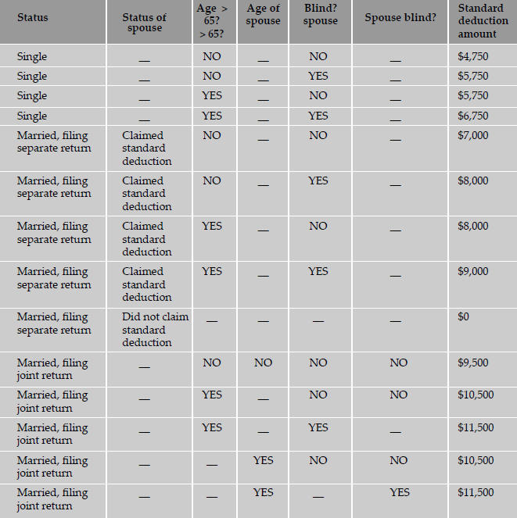
School of Computing Science and Engineering
“Black Box Testing "

Slide 20
School of Computing Science and Engineering
“Black Box Testing "
Decision tables act as invaluable tools for designing black box tests to examine the behavior of the product under various logical conditions of input variables. The steps in forming a decision table are as follows.
1. Identify the decision variables.
2. Identify the possible values of each of the decision variables.
3. Enumerate the combinations of the allowed values of each of the variables.
4. Identify the cases when values assumed by a variable (or by sets of variables) are immaterial for a given combination of other input variables. Represent such variables by the don't care symbol.
5. For each combination of values of decision variables, list out the action or expected result.
6. Form a table, listing in each but the last column a decision variable. In the last column, list the action item for the combination of variables in that row.

Slide 21
School of Computing Science and Engineering
“Black Box Testing "
1.5 Equivalence Partitioning: Equivalence partitioning is a software testing technique that involves identifying a small set of representative input values that produce as many different output conditions as possible.
The set of input values that generate one single expected output is called a partition. When the behavior of the software is the same for a set of values, then the set is termed as an equivalance class or a partition. In this case, one representative sample from each partition (also called the member of the equivalence class) is picked up for testing. Since all the values produce equal and same output they are termed as equivalence partition.
Testing by this technique involves:
(a) identifying all partitions for the complete set of input, output values for a product and
(b) picking up one member value from each partition for testing to maximize complete coverage.

Slide 22
School of Computing Science and Engineering
“Black Box Testing "
Let us consider the example below, of an insurance company that has the following premium rates based on the age group.
Life Insurance Premium Rates
A life insurance company has base premium of $0.50 for all ages. Based on the age group, an additional monthly premium has to be paid that is as listed in the table below. For example, a person aged 34 has to pay a premium=base premium + additional premium=$0.50 + $1.65=$2.15.
Age group Additional premium
Under 35 $1.65
35-59 $2.87
60+ $6.00

Slide 23
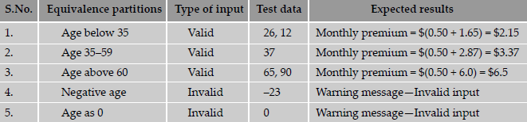
School of Computing Science and Engineering
“Black Box Testing "
Based on the equivalence partitioning technique, the equivalence partitions that are based on age are given below:
• Below 35 years of age (valid input)
• Between 35 and 59 years of age (valid input)
• Above 60 years of age (valid input)
• Negative age (invalid input)
• Age as 0 (invalid input)
• Age as any three-digit number (valid input)
Table 1.8 Equivalence classes for the life insurance premium example.

Slide 24
School of Computing Science and Engineering
“Black Box Testing "
1.6 State Based or Graph Based Testing: State or graph based testing is very useful in:-
1. The product is a language processor, wherein the syntax of the language automatically lends itself to a state machine or a context free grammar represented by a railroad diagram.
2. Workflow modeling where, depending on the current state and appropriate combinations of input variables, specific workflows are carried out, resulting in new output and new state.
3. Dataflow modeling, where the system is modeled as a set of dataflow, leading from one state to another.
Consider an application that is required to validate a number following simple rules.
1. A number can start with an optional sign.
2. The optional sign can be followed by any number of digits.
3. The digits can be optionally followed by a decimal point, represented by a period.
4. If there is a decimal point, then there should be two digits after the decimal.
5. Any number—whether or not it has a decimal point, should be terminated by a blank.

Slide 25
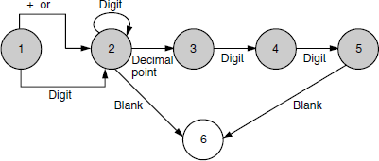
School of Computing Science and Engineering
“Black Box Testing "
Table 1.10 State transition table for Figure 1.3.
Current state Input Next state
1 Digit 2
1 + 2
1 - 2
2 Digit 2
2 Blank 6
2 Decimal point 3
3 Digit 4
4 Digit 5
5 Blank 6
Figure 1.3 An example of a state transition diagram.

Slide 26
School of Computing Science and Engineering
“Black Box Testing "
1.7 Compatibility Testing: Testing done to ensure that the product features work consistently with different infrastructure components is called compatibility testing.
The parameters that generally affect the compatibility of the product are
Processor(Pentium III, Pentium IV,, SPARC…) & number of processors in the machine
Architecture and characteristics of the machine (32 bit, 64 bit, and so on)
Resource availability on the machine (RAM, disk space, network card)
Equipment that the product is expected to work with (printers, modems, routers, and so on)
Operating system (Windows, Linux,) and operating system services (DNS, NIS, FTP)
Middle-tier infrastructure components such as web server, application server, network server
Backend components such database servers (Oracle, Sybase, and so on)
Services that require special hardware-cum-software solutions (cluster machines, load balancing, RAID array, and so on)
Any software used to generate product binaries (compiler, linker, and so on)

Slide 27
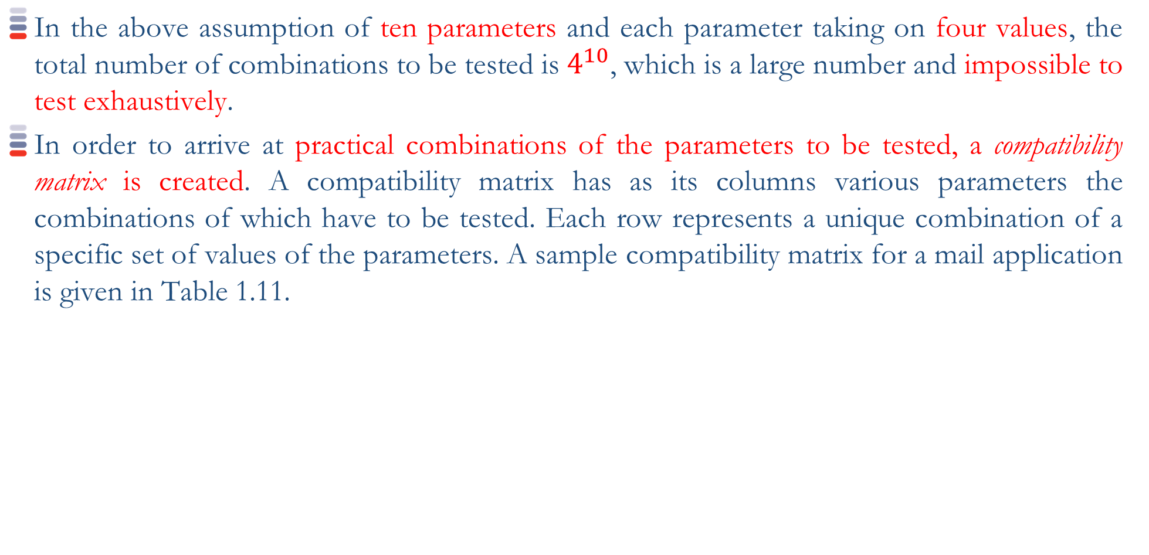
School of Computing Science and Engineering
“Black Box Testing "
In the above assumption of ten parameters and each parameter taking on four values, the total number of combinations to be tested is $4^{10}$, which is a large number and impossible to test exhaustively.
In order to arrive at practical combinations of the parameters to be tested, a compatibility matrix is created. A compatibility matrix has as its columns various parameters the combinations of which have to be tested. Each row represents a unique combination of a specific set of values of the parameters. A sample compatibility matrix for a mail application is given in Table 1.11.

Slide 28
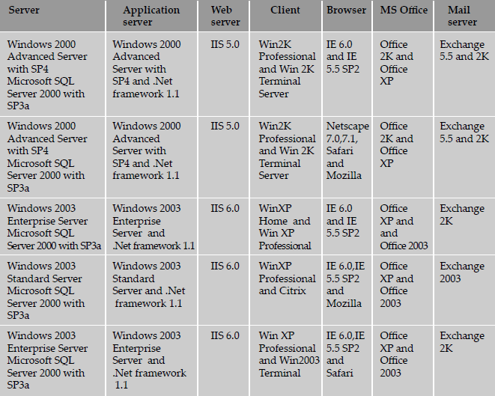
School of Computing Science and Engineering
Table 1.11 Compatibility matrix for a mail application.

Slide 29
School of Computing Science and Engineering
Some of the common techniques that are used for performing compatibility testing, using a compatibility table are
1. Horizontal combination All values of parameters that can coexist with the product for executing the set test cases are grouped together as a row in the compatibility matrix. Machines or environments are set up for each row and the set of product features are tested using each of these environments.
2. Intelligent sampling: Combinations of infrastructure parameters are combined with the set of features intelligently and tested. When there are problems due to any of the combinations then the test cases are executed, exploring the various permutations and combinations. The selection of intelligent samples is based on information collected on the set of dependencies of the product with the parameters. If the product results are less dependent on a set of parameters, then they are removed from the list of intelligent samples. All other parameters are combined and tested. This method significantly reduces the number of permutations and combinations for test cases.

Slide 30
School of Computing Science and Engineering
“Black Box Testing "
The compatibility testing of a product involving parts of itself can be further classified into two types.
1. Backward compatibility testing: The testing that ensures the current version of the product continues to work with the older versions of the same product is called backward compatibility testing.
2. Forward compatibility testing There are some provisions for the product to work with later versions of the product and other infrastructure components, keeping future requirements in mind. For example, IP network protocol version 6 uses 128 bit addressing scheme (IP version 4, uses only 32 bits). The data structures can now be defined to accommodate 128 bit addresses, and be tested with prototype implementation of Ipv6 protocol stack that is yet to become a completely implemented product.

Slide 31
School of Computing Science and Engineering
“Black Box Testing "
1.8 User Documentation Testing: User documentation covers all the manuals, user guides, installation guides, setup guides, read me file, software release notes, and online help that are provided along with the software to help the end user to understand the software system.
User documentation testing should have two objectives.
1. To check if what is stated in the document is available in the product.
2. To check if what is there in the product is explained correctly in the document.
User documentation testing focuses on ensuring what is in the document exactly matches the product behavior, by sitting in front of the system and verifying screen by screen, transaction by transaction and report by report. In addition, user documentation testing also checks for the language aspects of the document like spell check and grammar.
User documentation is done to ensure the documentation matches the product and vice-versa.

Slide 32
School of Computing Science and Engineering
Some of the benefits that ensue from user documentation testing are:
1. User documentation testing aids in highlighting problems over looked during reviews.
2. High quality user documentation ensures consistency of documentation and product, thus minimizing possible defects reported by customers. It also reduces the time taken for each support call. Thus the overall support cost is minimized.
3. Results in less difficult support calls. When a customer faithfully follows the instructions given in a document but is unable to achieve the desired (or promised) results, it is frustrating and often this frustration shows up on the support staff. Ensuring that a product is tested to work as per the document and that it works correctly contributes to better customer satisfaction and better morale of support staff.
4. New programmers and testers who join a project group can use the documentation to learn the external functionality of the product.
5. Customers need less training and can proceed more quickly to advanced training and product usage if the documentation is of high quality and is consistent with the product. Thus high-quality user documentation can result in a reduction of overall training costs for user organizations.

Slide 33
School of Computing Science and Engineering
“Black Box Testing "
1.9 Domain Testing:
White box testing required looking at the program code. Black box testing performed testing without looking at the program code but looking at the specifications.
Domain testing can be considered as the next level of testing in which we are testing the product, purely based on domain knowledge and expertise in the domain of application.
This testing approach requires critical understanding of the day-to-day business activities for which the software is written.
This type of testing requires business domain knowledge rather than the knowledge of what the software specification contains or how the software is written.
Thus domain testing can be considered as an extension of black box testing. As we move from white box testing through black box testing to domain testing (as shown in Figure 1.5) we know less and less about the details of the software product and focus more on its external behavior.

Slide 34
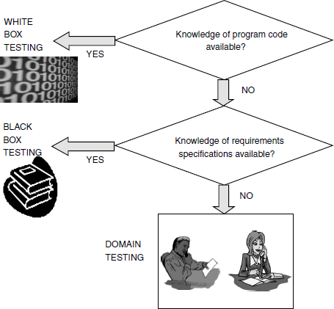
School of Computing Science and Engineering
“Black Box Testing "
Figure 1.5 Context of white box, black box and domain testing.

Slide 35
School of Computing Science and Engineering
“Black Box Testing "
The test engineers performing this type of testing are selected because they have in-depth knowledge of the business domain.
Domain testing is the ability to design and execute test cases that relate to the people who will buy and use the software. It helps in understanding the problems they are trying to solve and the ways in which they are using the software to solve them.
Domain testing exploits the tester's domain knowledge to test the suitability of the product to what the users do on a typical day.
Domain testing involves testing the product, not by going through the logic built into the product.
The business flow determines the steps, not the software under test. This is also called “business vertical testing.” Test cases are written based on what the users of the software do on a typical day.

Slide 36
School of Computing Science and Engineering
“Black Box Testing "
An example of cash withdrawal functionality in an ATM :
Step 1: Go to the ATM.
Step 2: Put ATM card inside.
Step 3: Enter correct PIN.
Step 4: Choose cash withdrawal.
Step 5: Enter amount.
Step 6: Take the cash.
Step 7: Exit and retrieve the card.
Hence the focus of domain testing has to be more on the business domain to ensure that the software is written with the intelligence needed for the domain.
To test the software for a particular “domain intelligence,” the tester is expected to have the intelligence and knowledge of the practical aspects of business flow.

Slide 37
School of Computing Science and Engineering
“Black Box Testing "
Thanks

